Slide 1
Fabric Defect Detection System
Software project summary report
reporter:eleven group
time:5.28

Slide 2
01. Project Completion Status
CONENT
02. Test Plan
03. Project Risk
04. Lesson Learnt
05. Conclusion and Future Work

Slide 3
01
Project Completion Status

Slide 4
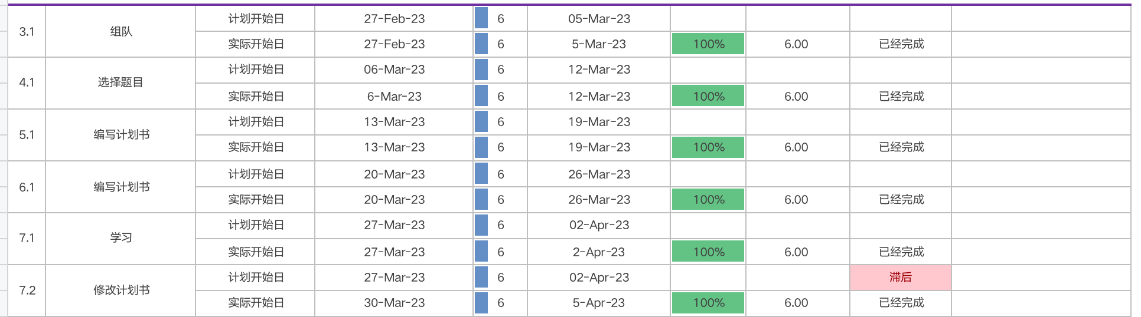
Project schedule
Time | Milestone | Description | Performance
Sprint 1
Week3 | Teamleader submits team list. |  | Completed.
Week 4 | Team leader submits the project and a brief description on the online document. |  | We successfully submited the project plan and did a brief presentation in class ,teacher gave the guidance.
Week 5 Week 6 | Team leader submits the project plan | Team leader submits the project plan at week 7. | We all finally submited the project plan which have been modified by guidance.
Week 7 | Team leader submits the modified project plan Everyone must submit a report about what you have learned in this week. |  | Completed.

Slide 5
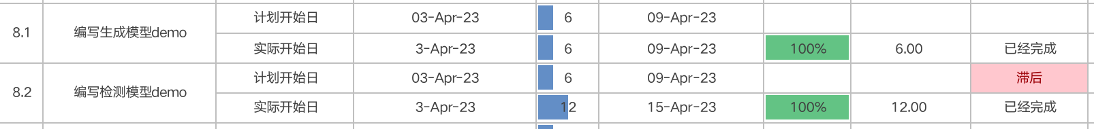
Project schedule
Time | Milestone | Description | Performance
Sprint 1
Week 8 | The member who is responsible for the model submits a demo. | The demo must be runnable and the member must submit the outcome of the demo. The outcome must be a picture or a document which shows the result of the model. | Our team member SongYuChen started doing the model,it took him two weeks to complete the model,later than our first plan. Meanwile,our team member XieYiChen started doing the model,his work went smoothly.

Slide 6
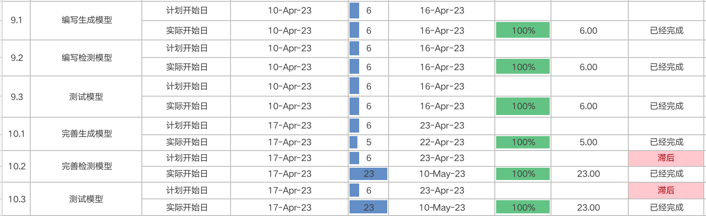
Project schedule
Time | Milestone | Description | Performance
Sprint 1
Week 9 Week10 | The member who is responsible for the model submits the model. | The model is used to solve most of the real problem we proposed. The model contains of souce code ,the parameter and outcome. The outcome must be a picture or a document which shows the result of the model. For detect model, the model need to detect the fabric defect and generate a picture with the result. For the first generative model, it need to generate a low-qulity picture. If the first generative model can not solve the problem, member need to submit the second generative model which can transfer a low-quality picture to a high-quality one. | Our team member Song still did his work. Our team member Xie has submit the complete model. We didn’t complete the work on time,we delay the plan.

Slide 7

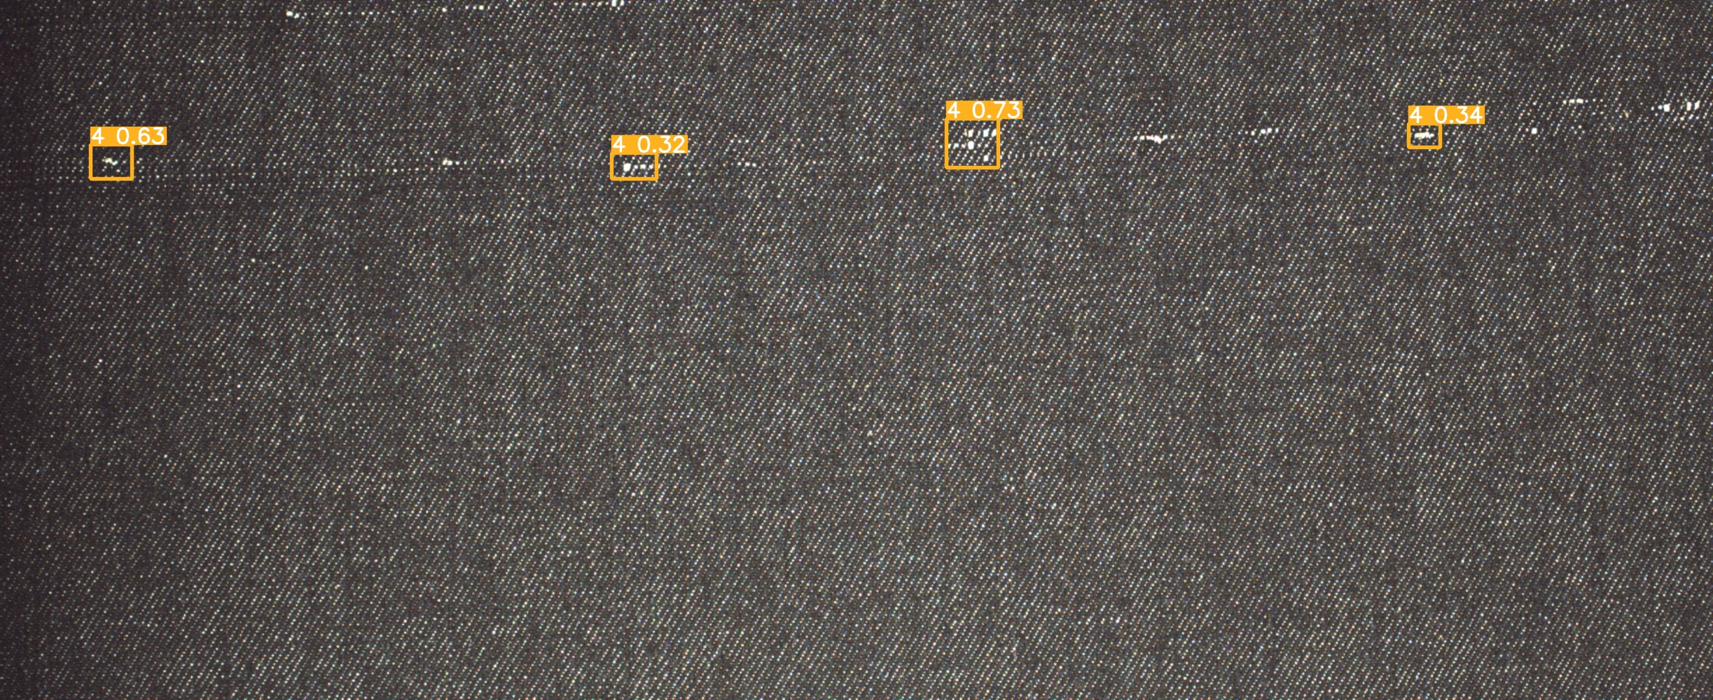
Detect
This is a picture that only passes the detection model and does not pass the generator model. It can be seen that the types of defects can be detected. However, after the processing of yolov5, the quality of the detection is hard to guarantee.

Slide 8


Slide 9


Slide 10


Slide 11
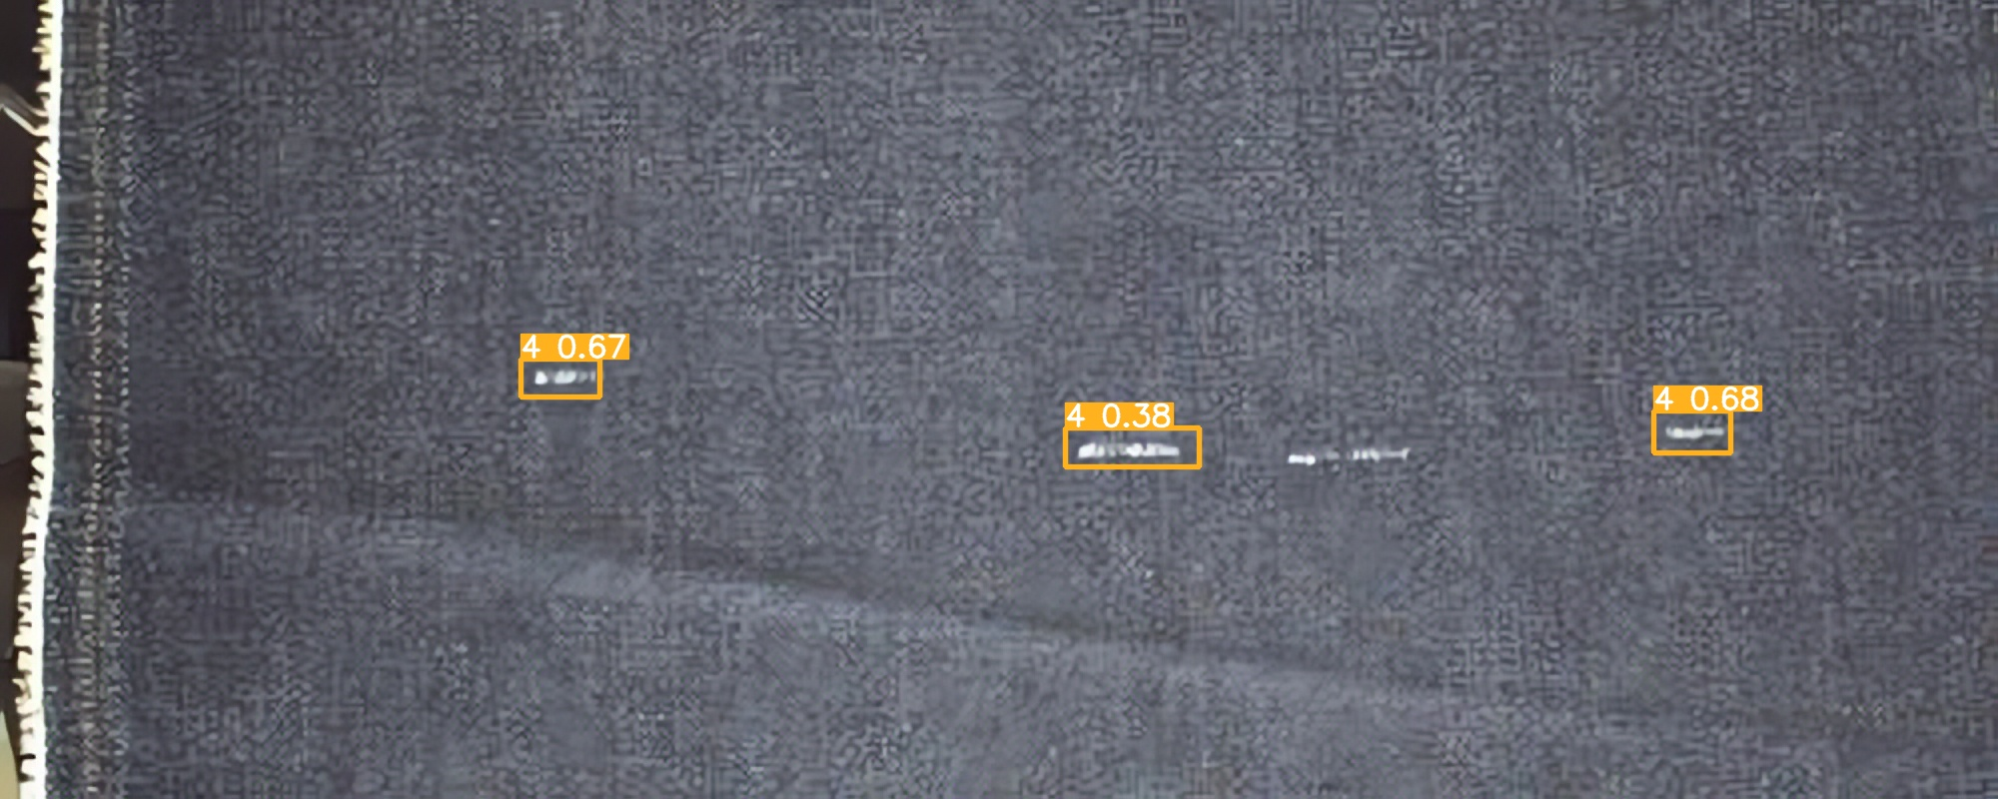

Slide 12

fake images
In the detect model, high qulity images with 2K resolution are used to train the model, but in real application scenarios, many images cannot achieve 2K resolution, so we proposed two method to solve this problem.Firstly, we can use low-qulity fabric images to fine-tune the model, but we lack a low-qulity image dataset, so we propose a solution: A generative model can be used to generate fake and low-quality images.
At the same time, for users who want to use the system but can not upload pictures for various reasons, the system can generate a picture for trying our system.

Slide 13



Original size
Secondly, if the first method can not solve the problem, we will try to use a genrative model to transfer a low-qulity picture to a high-quality picture so that the detect model can detect a high-qulity picture instead of a low-qulity picture.
Resize
Ours

Slide 14
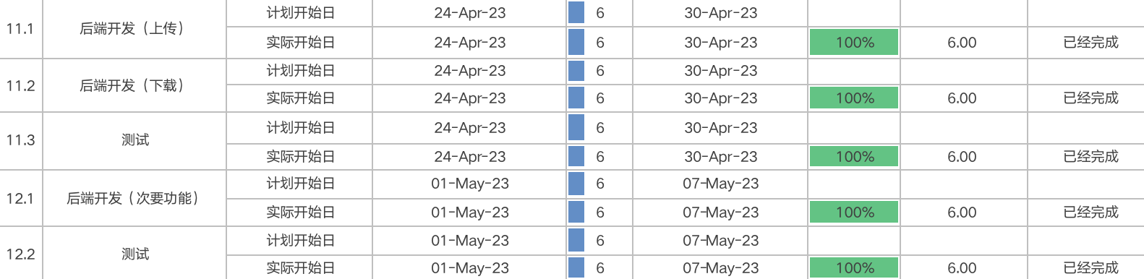
Project schedule
Sprint2
Week 11 Week 12 | The member submits the a module of the server. | The module can be used to solve the corresponding requirement. The main module need to upload the picture to the server and download the picture from the server. | Our team together did a simple module of the server. We ompleted the module on time.

Slide 15
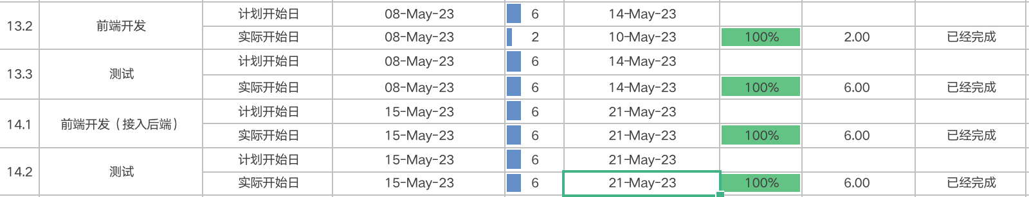
Project schedule
Sprint2
Week 13 Week 14 | The member submits the a module of web page. | The module can be used to solve the corresponding requirement. User can use the web page to download and upload picture for detect. User can use the web page to generate a picture for preview. | Our team together did a simple module of Web page.

Slide 16
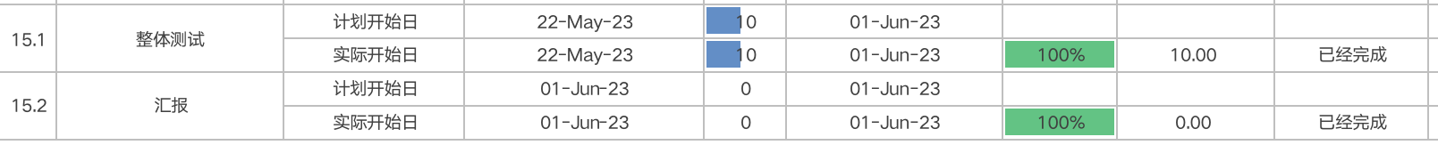
Project schedule
Sprint2
Week 15 Week16 | The teams submit the system. | Theteamgivethe presentation of the system. | Our team made a meeting and finally made the PPT doc and so on.

Slide 17
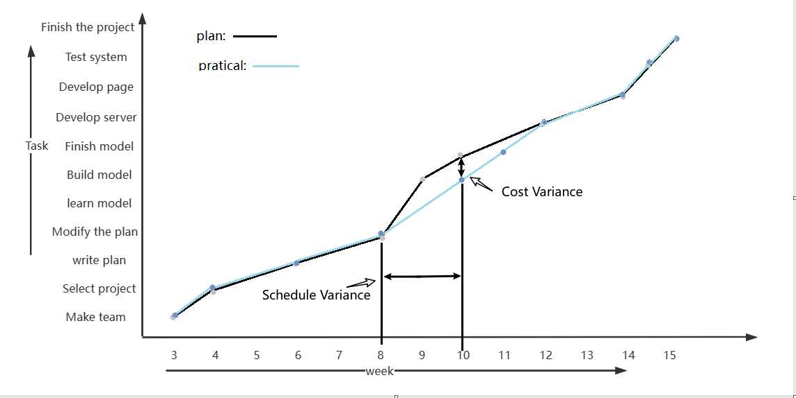
Project Cost
The picture of this page is the schedule cost of our team.We can see that we delay our plan at week8 for some members or our group be sick which led them can’t finish their work on time.

Slide 18
02
Test Plan

Slide 19
Test Plan
Test phase | Test tasks | Workload estimates | Staff | Start and finsh times
Model Test | Modify the model. | 14 Days | Testers | 4.10-4.23
FunctionTests | Test the defect of the system. | 28 Days | Testers | 4.24-5..21
API Tests | Test the api of the system. | 10 Days | Testers | 5.22-6.1
Help and user manual tests | 1. Help test2. User manual test | 10 Days | Testers | 5.22-6.1
Test instructions | Test summary and analysis, problem feedback | 10 Days | Testers | 5.22-6.1
The complete content is in the doc of test plan.

Slide 20
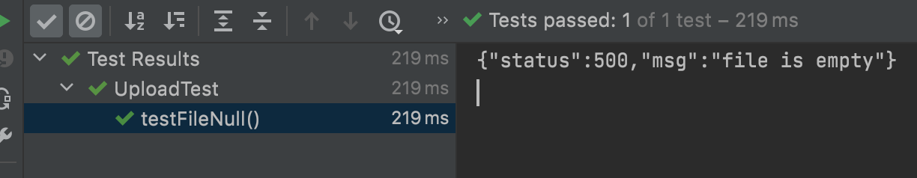
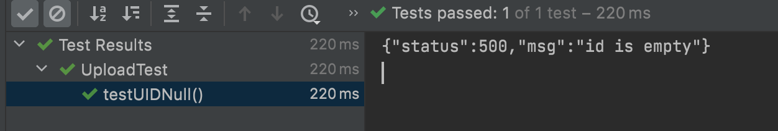
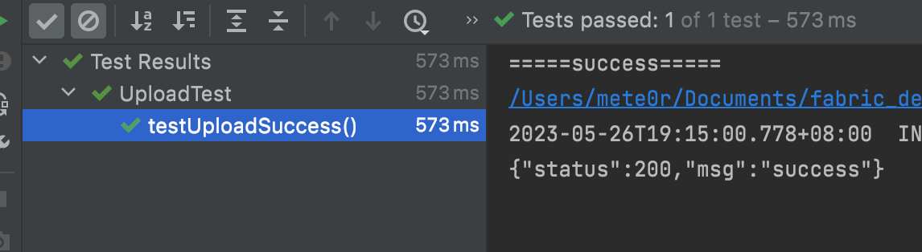
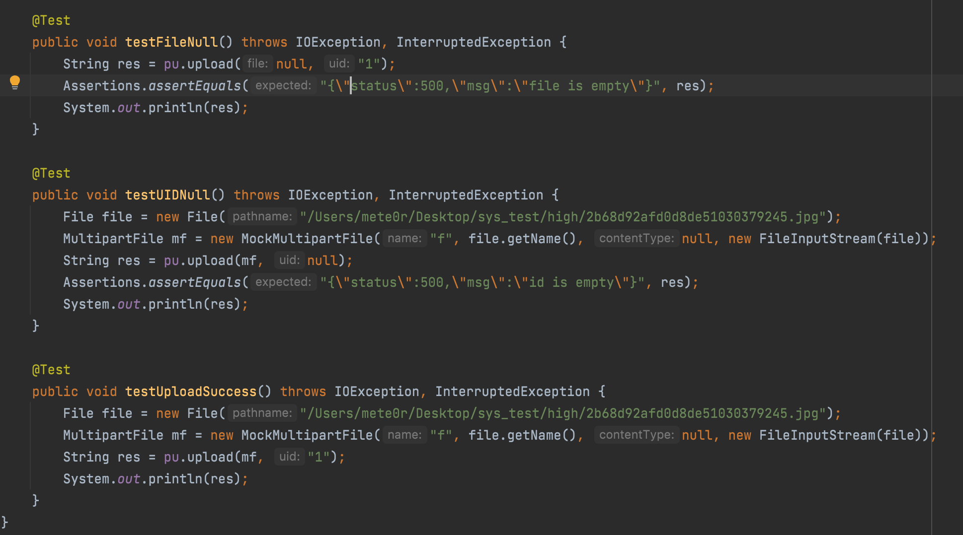
Test Case | File is empty
Input | Expected | Actual
File(null) | {"status":500,"msg":"file is empty"} | {"status":500,"msg":"file is empty"}
Test Case | UID is empty
Input | Expected | Actual
File(a .jpg file)Uid(null) | {"status":500,"msg":"id is empty"} | {"status":500,"msg":"id is empty"}
Test Case | Upload Success
Input | Expected | Actual
File(a .jpg file)Uid("1") | {"status":200,"msg":"success"} | {"status":200,"msg":"success"}
File(a .jpg file) *10Uid("1") | {"status":200,"msg":"success"} | {"status":200,"msg":"success"}

Slide 21
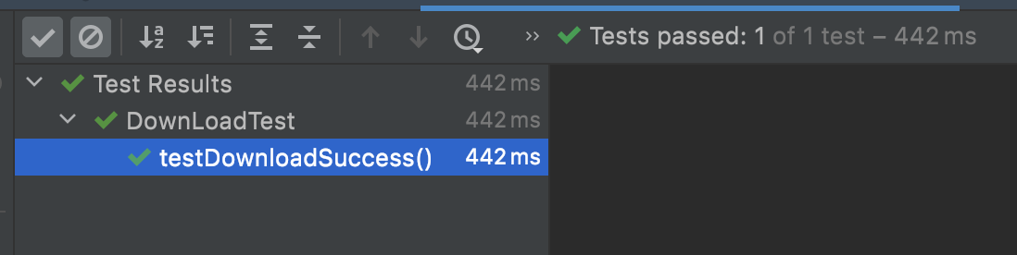
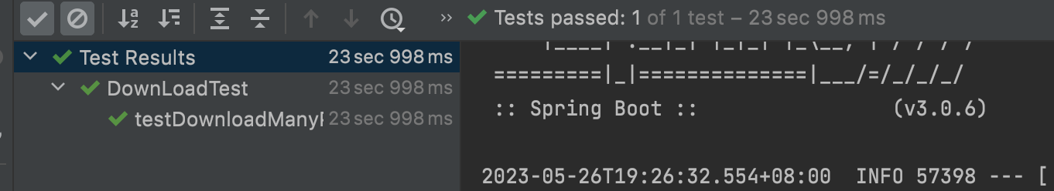
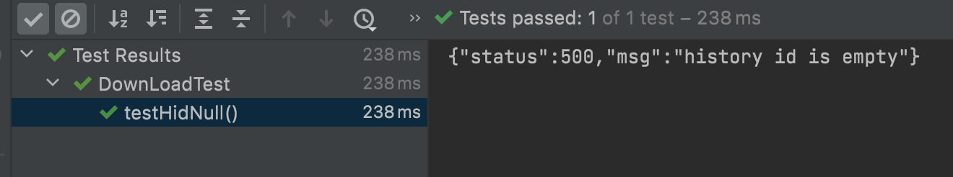
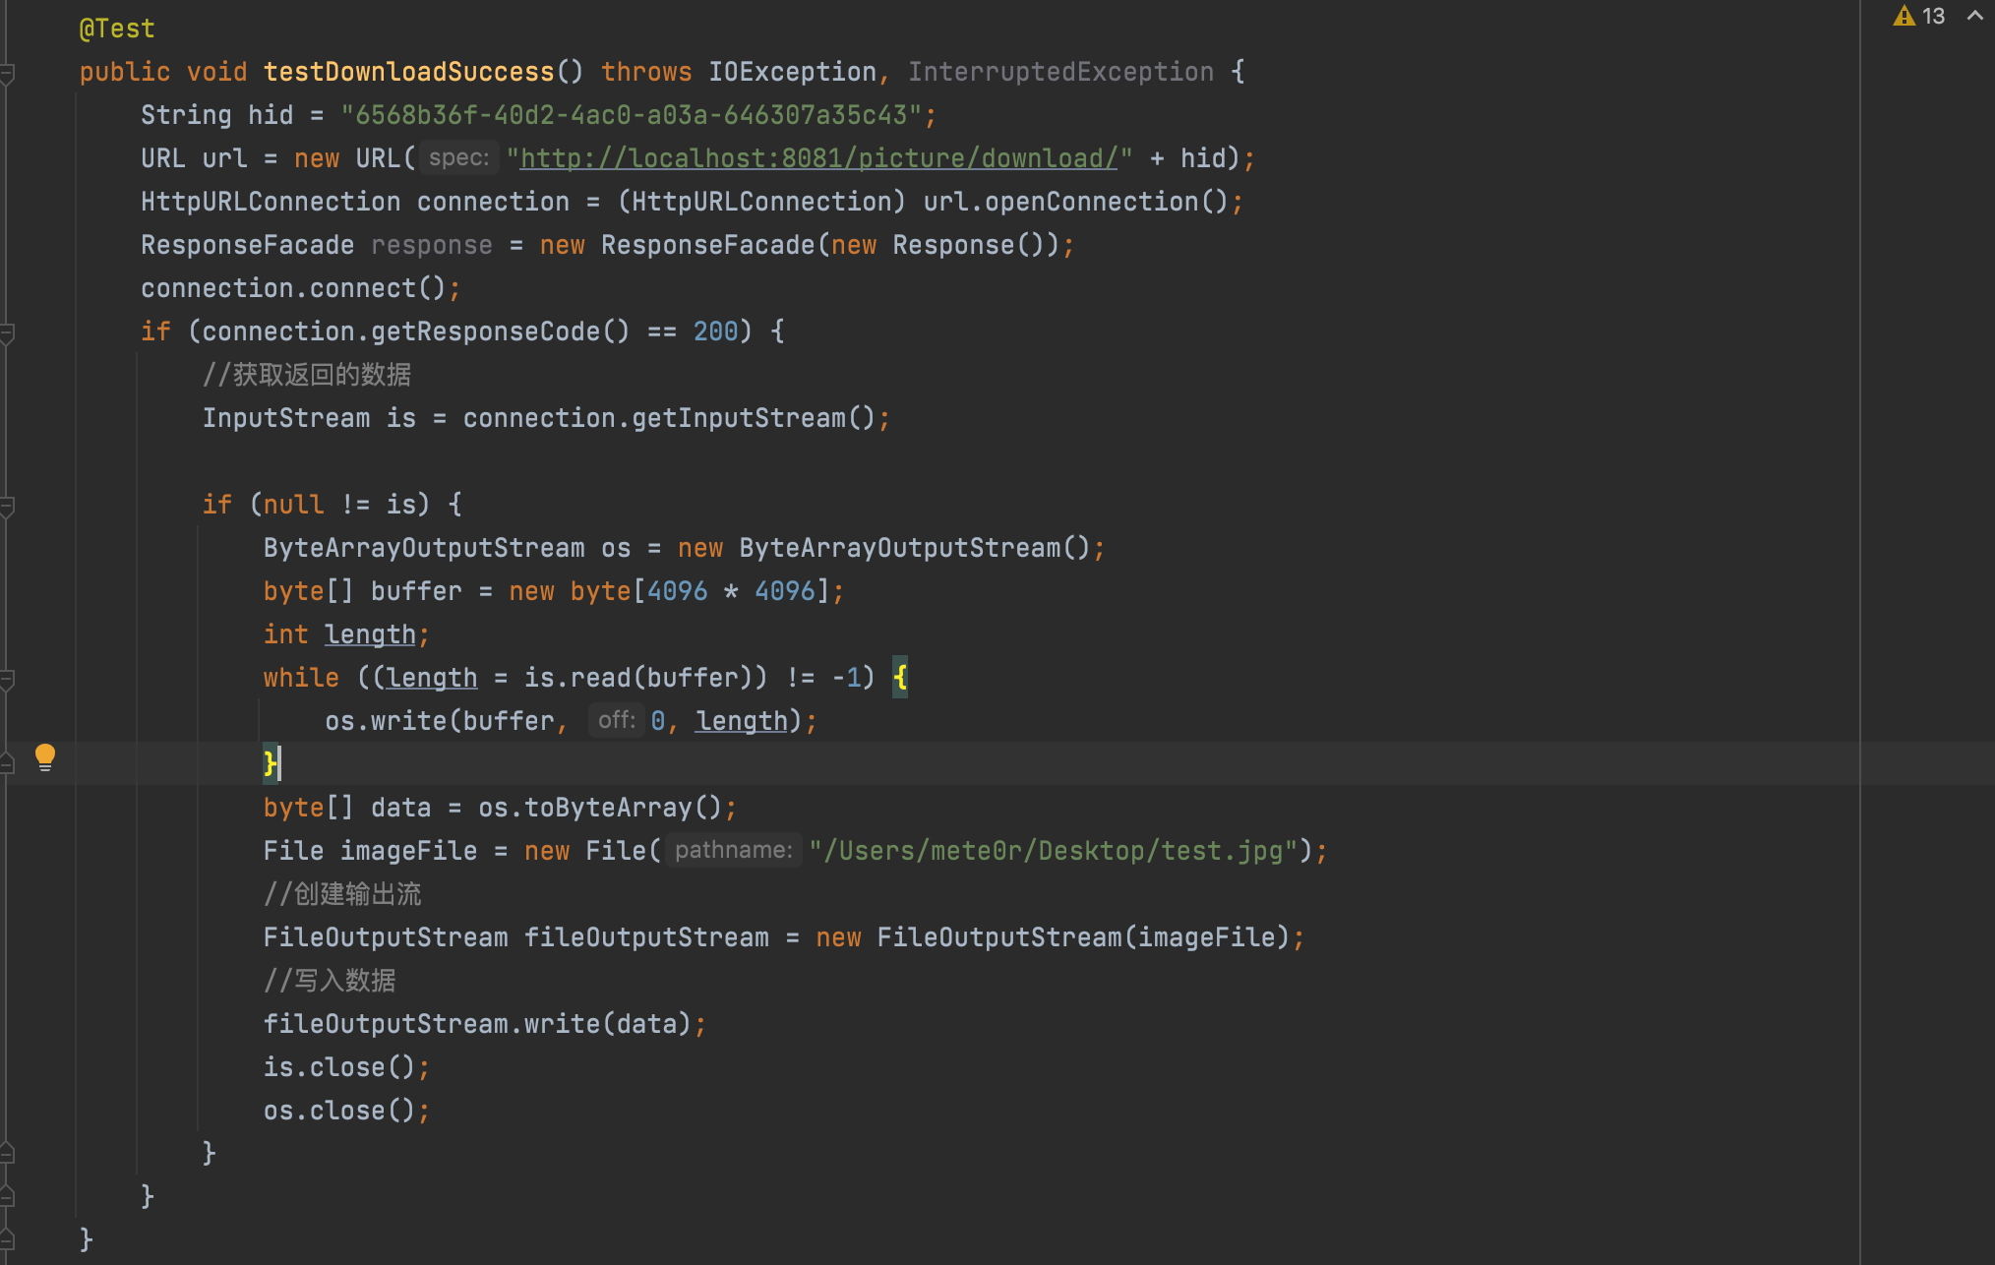
Test Case | Download a picture
Input | Expected | Actual
History(historyId=6568b36f-40d2-4ac0-a03a-646307a35c43,uId=null,time=null,inputPath=null,outPath=null,filename=null) | A file(test.jpg) | A file(test.jpg)
Test Case | Download a picture for many times
Input | Expected | Actual
10000*History(historyId=6568b36f-40d2-4ac0-a03a-646307a35c43,uId=null,time=null,inputPath=null,outPath=null,filename=null) | A file(test.jpg) | A file(test.jpg)
Test Case | Download a picture
Input | Expected | Actual
History(historyId=6568b36f-40d2-4ac0-a03a-646307a35c43,uId=null,time=null,inputPath=null,outPath=null,filename=null) | A file(test.jpg) | A file(test.jpg)

Slide 22
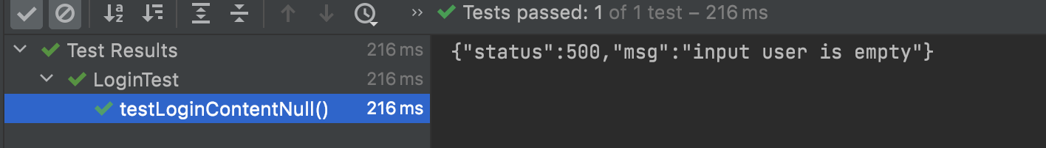
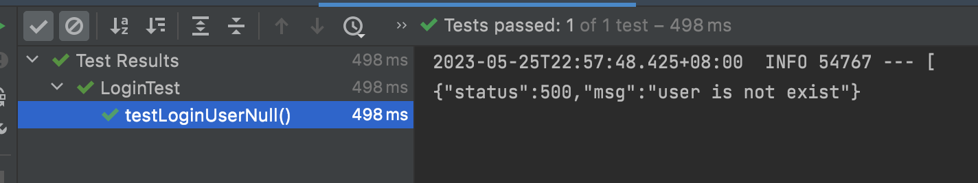
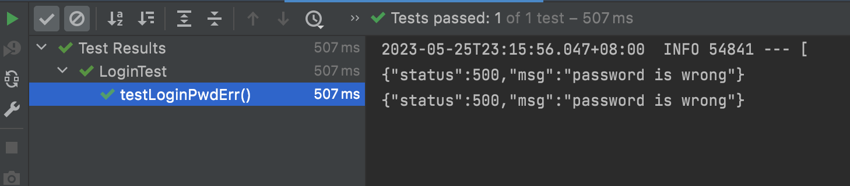
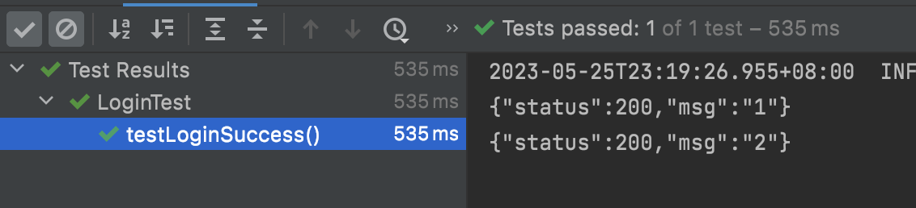
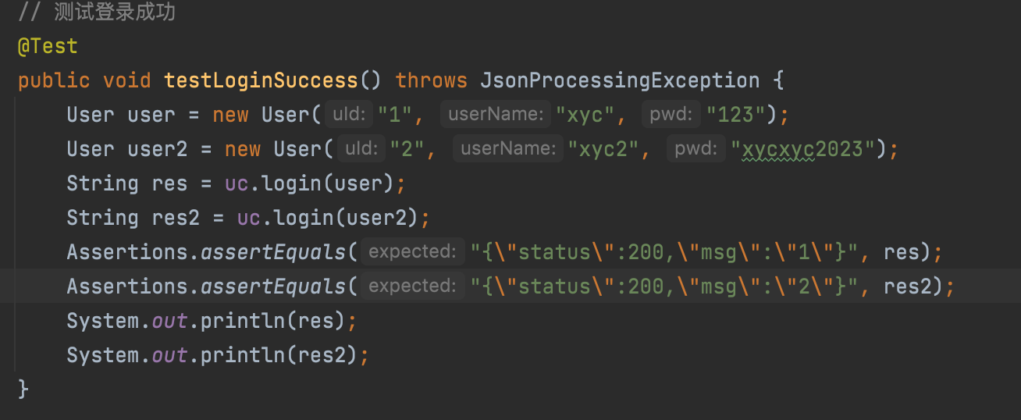
Test Case | User is Null
Input | Expected | Actual
User(null) | {"status":500,"msg":"input user is null"} | {"status":500,"msg":"input user is null"}
Test Case | User is not exist
Input | Expected | Actual
User(uid=1123,username=xyc123,pwd=19991208) | {"status":500,"msg":"user is not exist"} | {"status":500,"msg":"user is not exist"}
Test Case | Pwd is wrong
Input | Expected | Actual
User(uid=1,username=xyc,pwd=19991208) | {"status":500,"msg":"password is wrong"} | {"status":500,"msg":"password is wrong"}
User(uid=1,username=xyc2,pwd=dfasdasasdas) | {"status":500,"msg":"password is wrong"} | {"status":500,"msg":"password is wrong"}
Test Case | Login Success
Input | Expected | Actual
User(uid=1,username=xyc,pwd=123) | {"status":200,"msg":"1"} | {"status":200,"msg":"1"}
User(uid=2,username=xyc2,pwd=xycxyc2023) | {"status":200,"msg":"2"} | {"status":200,"msg":"2"}

Slide 23
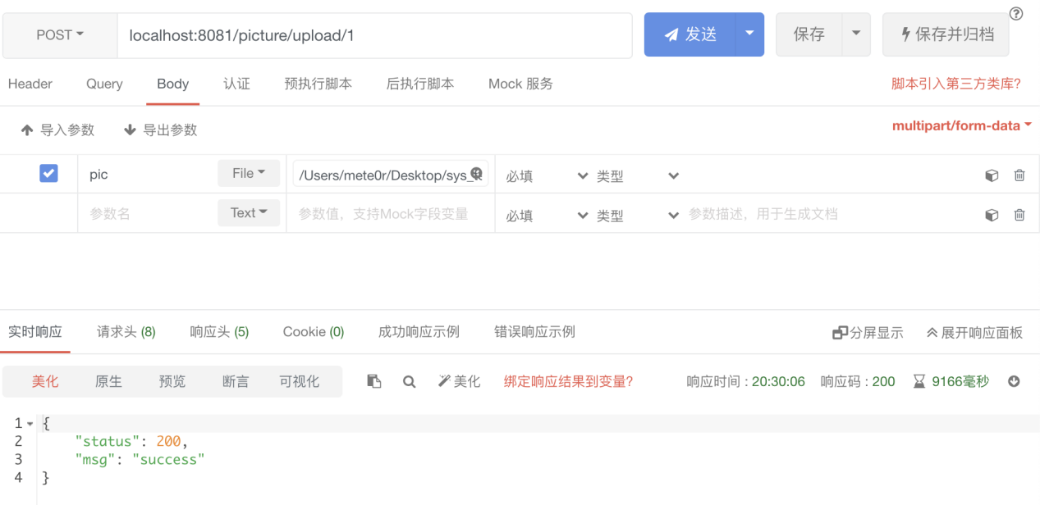
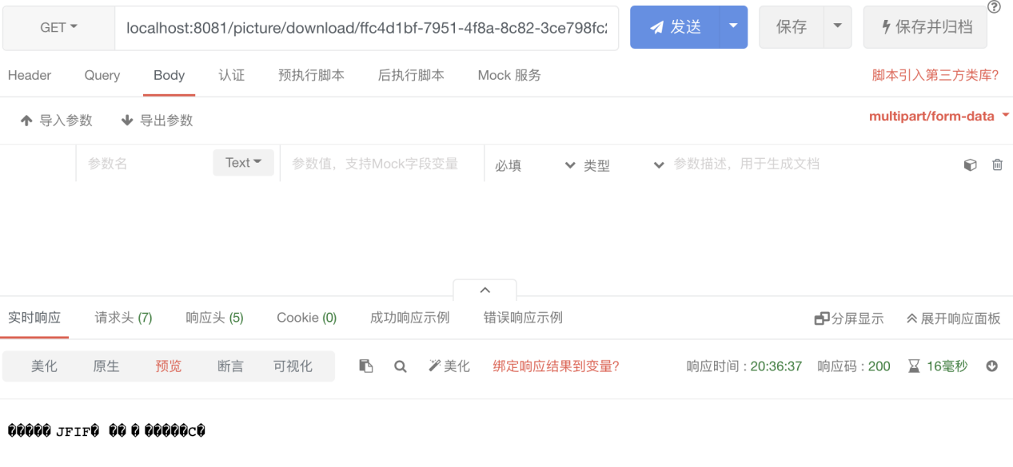
Method | POST
URL | /picture/upload
RequestParameter | Field | Type | Description
 | pic | file | A picture
 | uId | string | A path parameter
Response | Filed | Type | Description
 | status | number
 | msg | string
Method | Get
URL | /picture/download
RequestParameter | Field | Type | Description
 | hid | string | A path parameter
Response | Filed | Type | Description
 | file | file | A byte stream of the picture

Slide 24
Show the complete test case and api doc.

Slide 25
03
Project Risk

Slide 26
Project Risks
During the execution of the project, it is inevitable that there will be various kinds of accidents, which may lead to the failure of the whole project. Actually,we did encounter a lot of difficulties, and we can even say that we went through all the risks we listed, such as illness/exams/internship interviews, etc. The following table compares the final impact on the project after we encountered the risks.
Risk number | RiskType | Risk description | Impact | Danger | Solution
T1 | Human Resources Risk | Due tothe changes of preson among project memberswhoisunable to continue participating in the project. | Medium | Medium | PM must hold at least two group meetings per week to communicate project progress.Each person should present theirworksand trying to make everyone aware of the details of thework.2. Increase the workload by 1.5 hours per week.
T2 | ManagementRisk | Risk of poor communication | Medium | low | 1.PM should hold weekly group meeting to discuss project progress. 2.PM must establisha WeChat group where team members can discuss technical difficultiestimely

Slide 27
Project Risks
T3 | Schedule Risk | Unable to complete due to time constraints.The project plan may faces delays. | High | High | 1.PM should makea reasonableschedule. 2.During the weeklygroup meeting, if any team member fails to complete the planned workon time due to some reasons, the member will increase their working time next week to compensate previous week's workor other team members will assist
T4 | Technical Risks | 1.Technical difficulties leadingto project schedule delays.2.Team is unable to builda robust model due to hardware performance.3.Team chooses a wrong model that can’t solve the problem proposed. | High | Medium | 1.Developer should design a reasonable system architecture andimprove code quality.2.The performance of the model can be allowed to be weak，but it must be able to complete corresponding tasks.
T5 | Requirement Risk | Frequent changes ofrequirements lead tothe delay of development progress. | High | High | Two weeks after the start of the course,PM should hold one or twogroup meetings per week to strengthen communication, clarify project and requirements.Team members need to inform the project manager of the new requirement, and the project manager will organize a meeting to discuss whether to add the new requirement. If all team members agree, the new requirement will be added.

Slide 28
Project Risks
T6 | Technical Risks | System defects and vulnerabilities leadsto data leakage or system paralysis | High | High | Developer should design a system security mechanism based on industry standards and security requirements to encrypt, store, and transmit sensitive information; Conduct periodic vulnerability scanning to enhance data backup and disaster recovery
T7 | ManagementRisk | The difference in the ability and level of the project management team brings uncertainty risk to the project construction. These management capabilities and levels include: the preparation and implementation of project schedule plan, the ability to plan and manage project human resources, the ability to manage project change, the ability to manage project communication, and the ability to manage project risk. | High | High | Each team member needs to be familiar with project management and keep learning.At the same time, it is necessary to strengthen communication. When there is any problem, it is necessary to inform the project manager, and then the project manager organizes a meeting to discuss.

Slide 29
04
Lesson Learnt

Slide 30
Lesson Learnt
Plan is the most important document in the project because it directly affects the success of our project.Before making a plan, PM must consider various possible situations and provide a more reasonable plan.Meanwhile,PM also needs to set reasonable milestones to ensure that the project can be completed on time.
Communication is important.When encountering with some problem, informing the PM is the first thing that needs to be done.The PM needs to gather group members and have a meeting to discuss the solution of an unexpected issue that has arisen.
Risk Management is necessary.The cycle of a project is long, and it is inevitable to encounter various strange problems. Therefore, we need to manage and control this risk which affecting the progress of the entire project.

Slide 31
05
Conclution and Future Work

Slide 32
Conclution
On the whole, our project was succeed, and all the planned function were available, however, there were still many shortcomings. There were many functions and modules that were not as good as expected. For example, the accuracy of the object detection model was not high enough, the quality of the generative model was not good enough, and the server and web page were also simple.When testing,we did not consider the various issues that may arise when deploying the system to the production environment

Slide 33
Future Work
For the model, we will attempt to replace the model with a more robust and high-performance model so that we can achieve better generation and detection results.
For app,nowadays, most people often use their phones to handle some tasks instead of using web pages on their computers. Therefore, we need to adapt our software to browsers on mobile phone.If we have more time, we also need to develop a WeChat mini program so that users can use our program on WeChat directly.
For future plan,before making a plan, we need to focus on considering every possible risk, develop a reasonable plan, and reserve some time to avoid unexpected situations

Slide 34
Thank you for your watching!

